Slide 1

Mobile Communications and Orchestration
Part ½ - introduction to the internet of things
University of western Macedonia
Christos DalamagKAS – CDALAMAGKAS@UOWM.GR

Slide 2
Outline
Introduction to 5G
5G Definition and Characteristics
5G Spectrum Plan
Architecture
5G Features
Slicing
Massive MIMO
Network Evolution
C-RAN
MEC

Slide 3
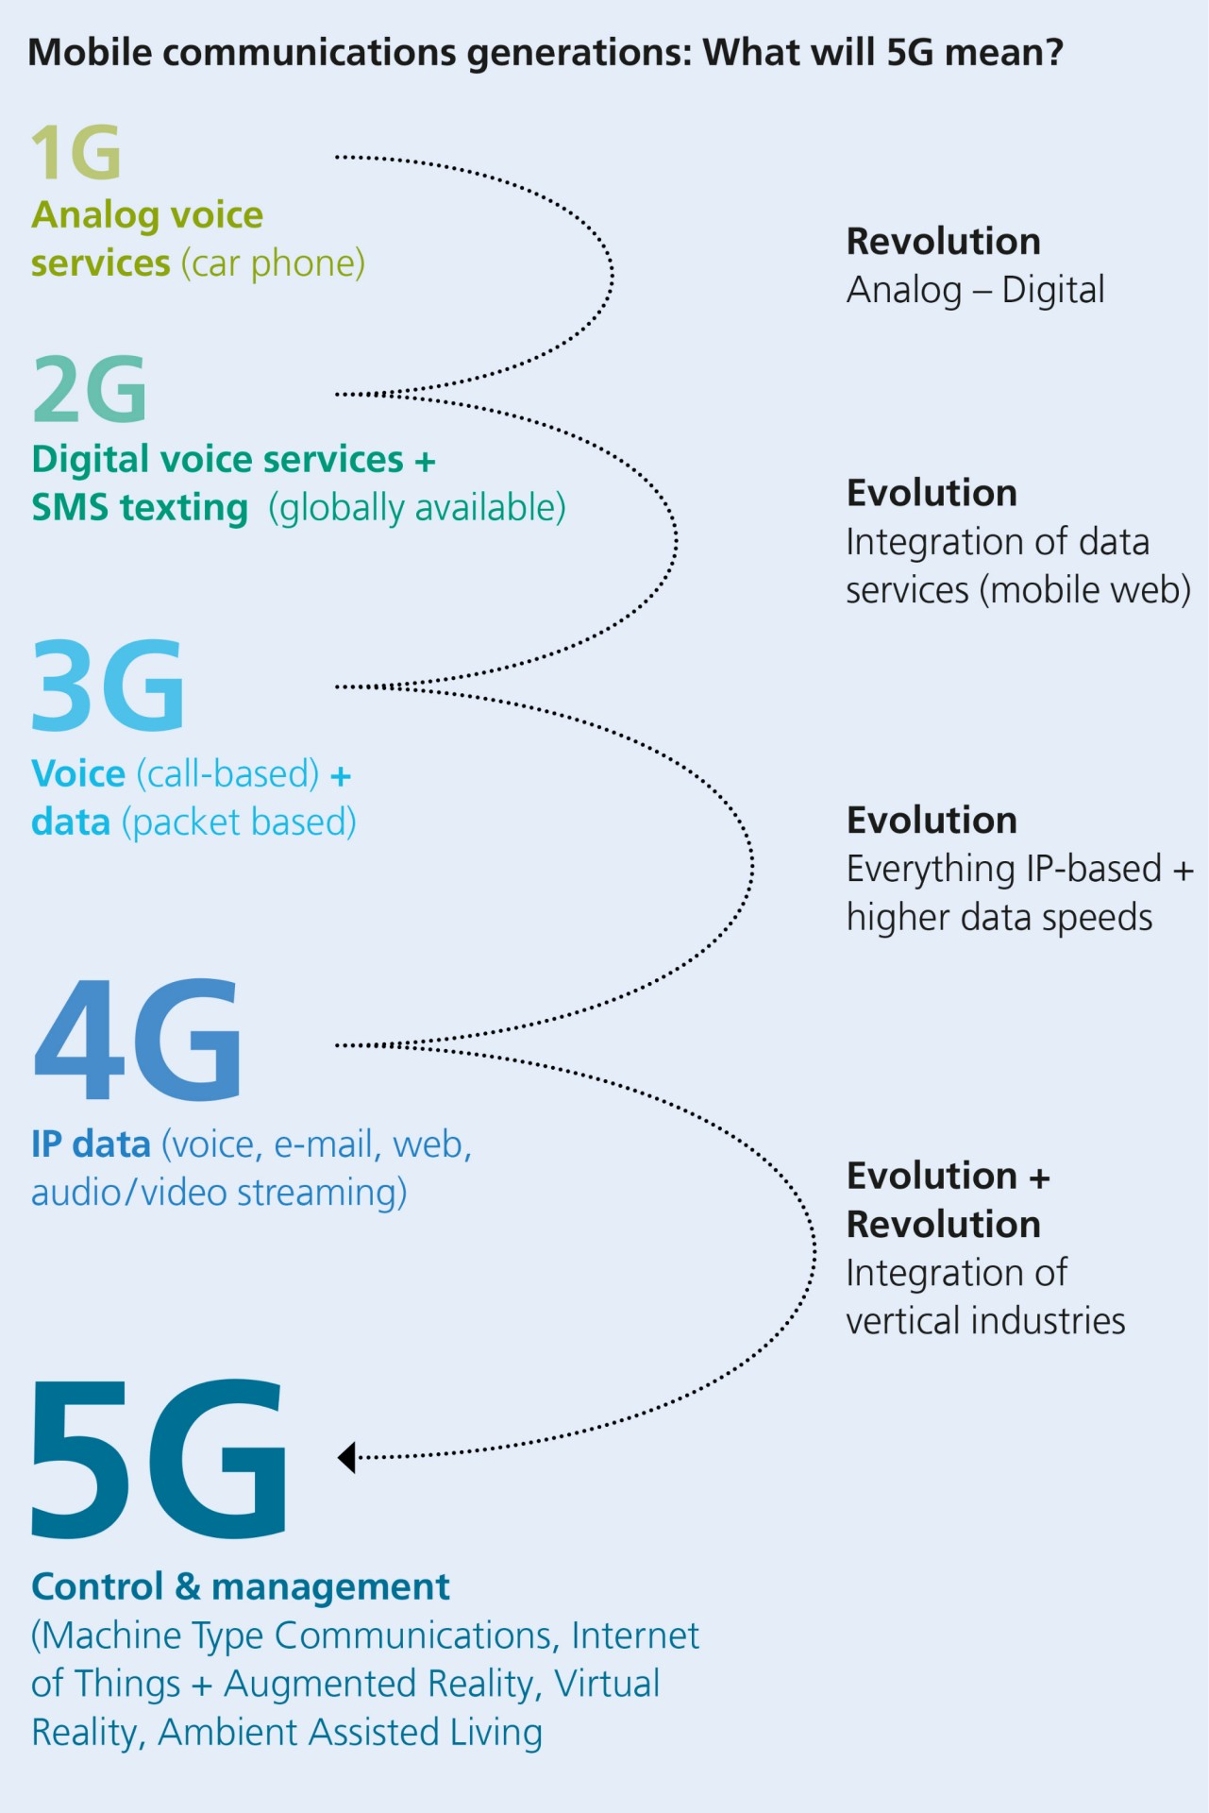
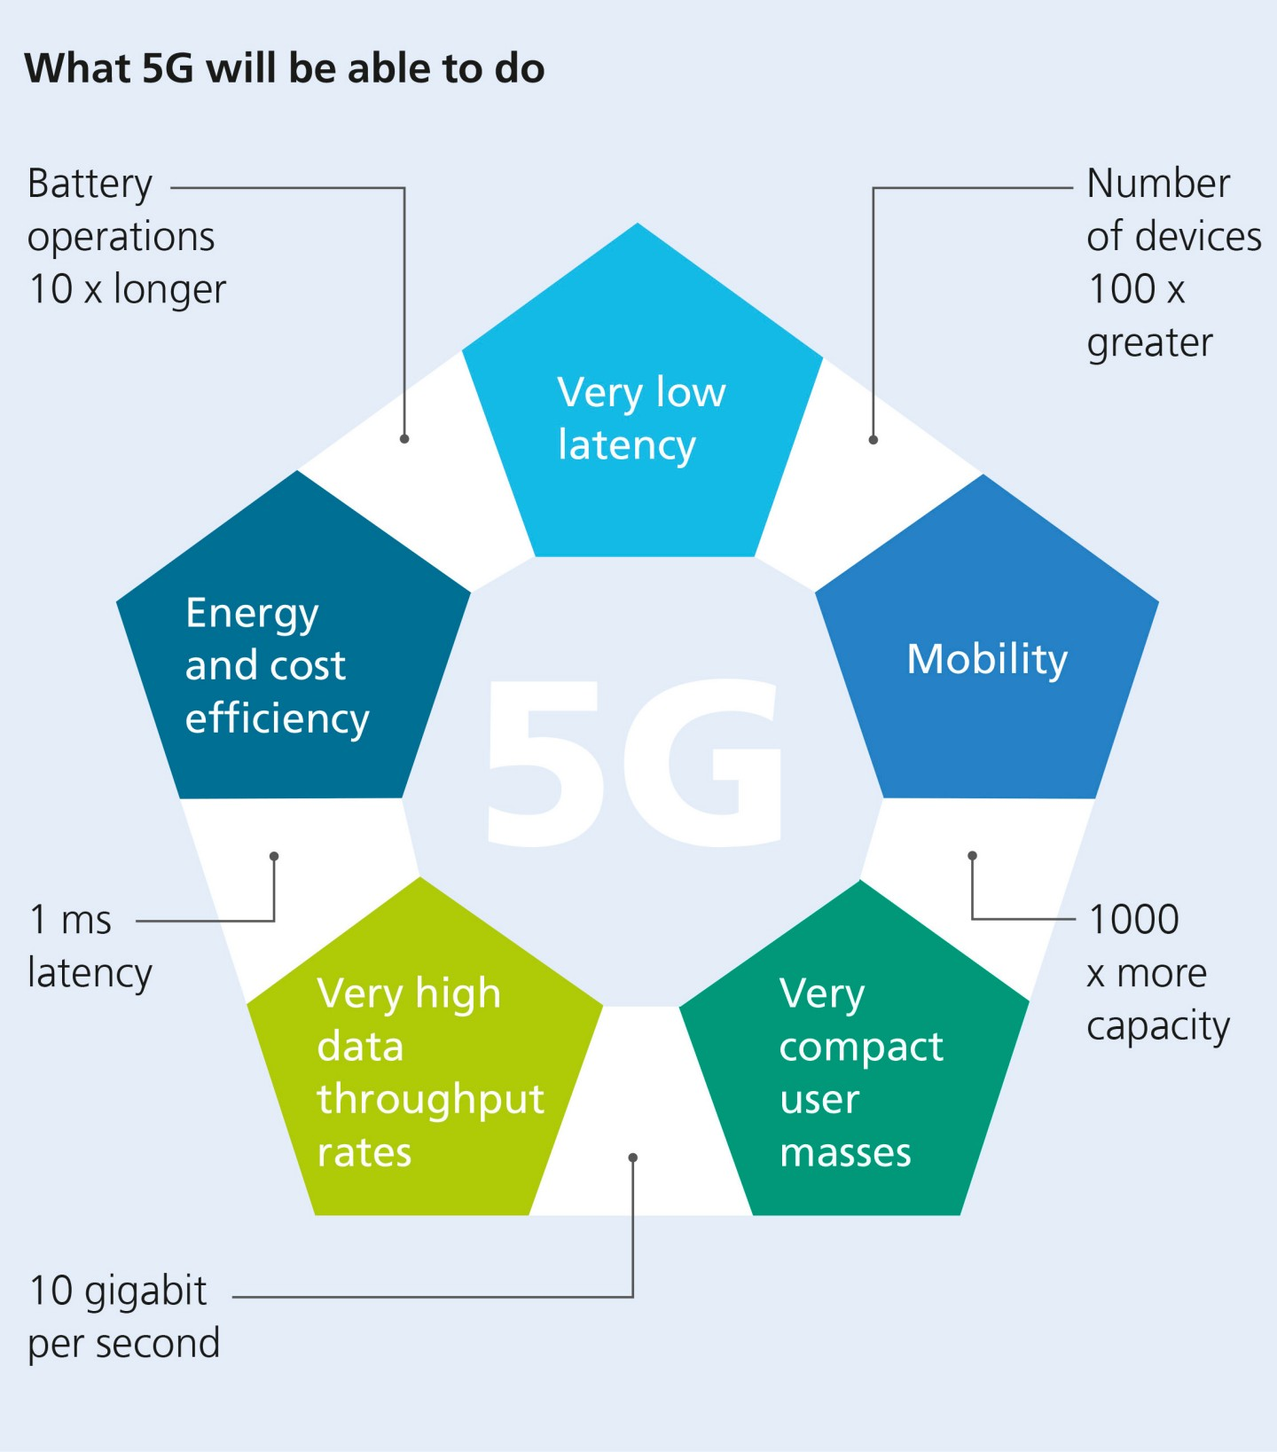
https://www.fraunhofer.de/en/research/current-research/tactile-internet.html#:~:text=This%20refers%20to%20Internet%2Dbased,telemedicine%20and%20Car2Car%20communication%20possible.

Slide 4
Why do we need 5G?
Main enabler for next-generation IoT applications
High capacity and density
Low latency
New emerging use cases that have increased demands
High throughput (20+ Mbps)
Low (< 10ms) or Ultra-low (< 1ms) latency
Virtualisation (decoupling software from hardware) pressures for new software-oriented architecture
No dedicated hardware → Programmable and reusable hardware
Overcome communication-related barriers that limit and slow down application
}
Pave the way for massive IoT deployments

Slide 5
5G Enablers
Network Function Virtualisation (NFV)
Software-Defined Networking (SDN)
Advancements in signal processing and telecom
Massive MIMO
Beamforming
Scalable OFDM
More efficient channel coding – Low-density parity check (LDPC)
https://arxiv.org/pdf/1806.07316.pdf

Slide 6
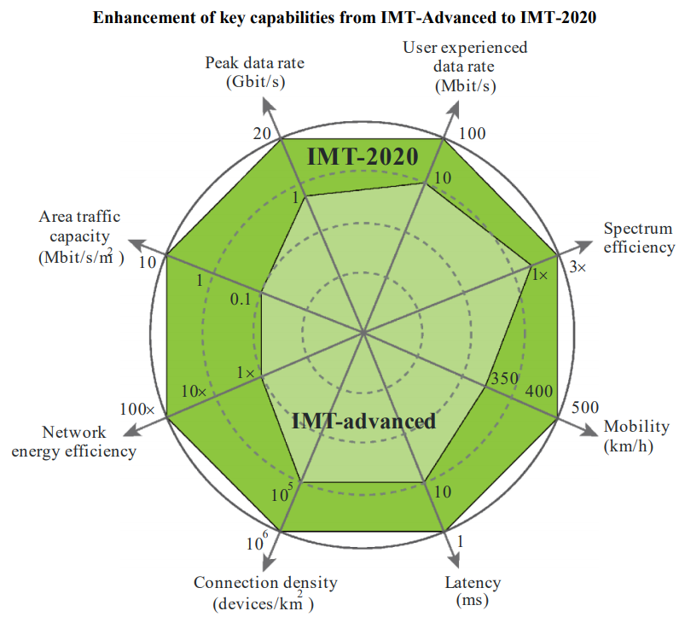
5G Definition
A summary of 5G-related key capabilities provided by ITU (International Telecommunication Union)
International Mobile Telecommunications (IMT) Advanced is a set of requirements issued by ITU-R (Radiocommunication sector of ITU) → Known as 4.5G
IMT-2020 are the requirements corresponding to 5G
https://www.itu.int/dms_pubrec/itu-r/rec/m/R-REC-M.2083-0-201509-I!!PDF-E.pdf

Slide 7
5G Characteristics
Peak Data Rate: max rate per user under ideal conditions. 10 Gbps for mobiles, 20 Gbps under certain conditions.
User experienced Data Rate: 95% Rate across the coverage area per user. 100 Mbps in urban/suburban areas. 1 Gbps hotspot.
Latency: Radio contribution to latency between send and receive
Mobility: Max speed at which seamless handover and QoS is guaranteed
Connection Density: Devices per km2
Energy Efficiency: Network bits/Joule, User bits/Joule
Spectrum Efficiency: Throughput per Hz per cell
Area Traffic Capacity: Throughput per m2
https://www.cse.wustl.edu/~jain/cse574-18/

Slide 8
5G Characteristics
Spectrum and Bandwidth Flexibility: Ability to operate at different frequencies and channel bandwidths
Reliability: High availability
Resilience: Continue working in face of disasters
Security and Privacy: Confidentiality, Integrity, Authentication, Protection against hacking, denial of service, man-in-the-middle attacks
Operational Lifetime: Long battery life for IoT devices

Slide 9
5G Applications
Three Key Application Areas:
Enhanced Mobile Broadband (eMBB): Better cell phones and hot spots. High data rates, high user density. Human centric communications
Ultra-Reliable and Low-Latency Communications (URLLC): Vehicle-to-Vehicle communication, Industrial IoT, 3D Gaming. Human and Machine centric communication
Massive Machine Type Communications (mMTC): Very large number of devices, low data rate, low power. IoT with long battery lifetime. Addition to LoRa, Zigbee, etc. Machine-centric communication.

Slide 10
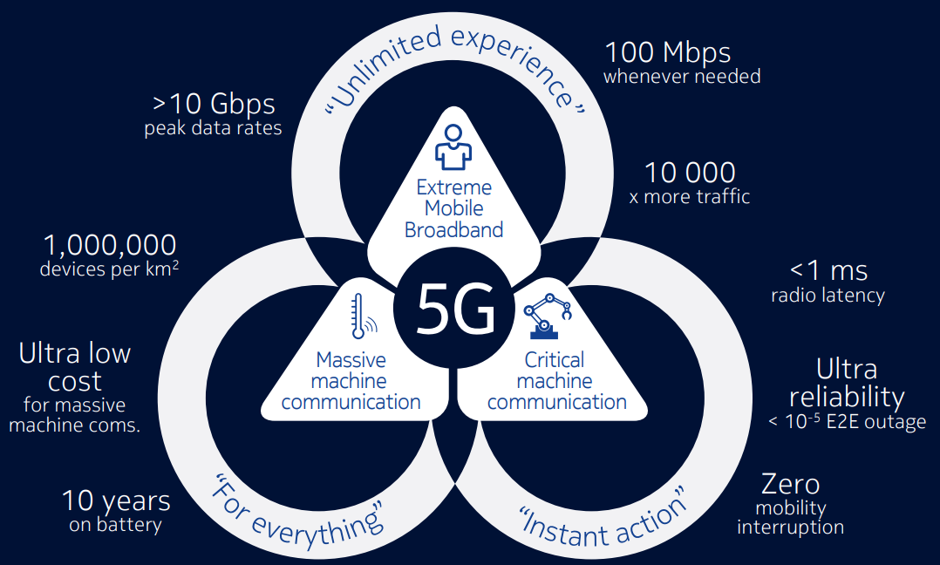
5G Applications and KPIs
https://www.itu.int/en/ITU-D/Regional-Presence/Europe/Documents/Events/2017/Spectrum%20Management/Ulrich__Nokia__5G_in%20700w.pdf

Slide 11
5G Requirements
Parameter | Minimum Requirement
Peak Data Rate | 20 Gbps DL, 10 Gbps UL
Peak Spectral Efficiency | 30 bps/Hz DL, 10 bps/Hz UL
User Experienced Data Rate | 100 Mbps DL, 50 Mbps UL
User Spectral Efficiency | 3× 4G
Area Traffic Capacity | 10 Mbps/m2 (Indoor hot spot)
User Plane Latency | 4 ms for eMBB, 1 ms for URLLC
Control Plane Latency | 20 ms
Connection Density | 1 M devices/km2
Reliability | 99.999% in Urban macro cell edge for URLLC
Mobility | 1.5 × 4G
Mobility Interruption time | 0 ms
Bandwidth | At least 100 MHz and up to 1 GHz in higher bands. Scalable bandwidth support required.

Slide 12
3G vs. 4G vs. 5G
Feature | 3G | 4G | 5G
Download waveform | CDMA | OFDMA | OFDMA, SCFDMA
Upload waveform | CDMA | SCFDMA | OFDMA, SCFDMA
Channel coding | Turbo | Turbo | LFPC (Data)/Polar (Control)
Beamforming | No | Data only | Full support
Spectrum | 0.8 – 2.1 GHz | 0.4 – 6 GHz | 0.4 – 52.6 GHz
Network Slicing | No | No | Yes
QoS | Bearer based | Bearer based | Flow based
Small Packet Support | No | No | Connectionless
Cloud Support | No | No | Yes
https://www.multefire.org/wp-content/uploads/5G_Standard_Toskala_MUulteFire-Open-Day-Meeting.pdf

Slide 13
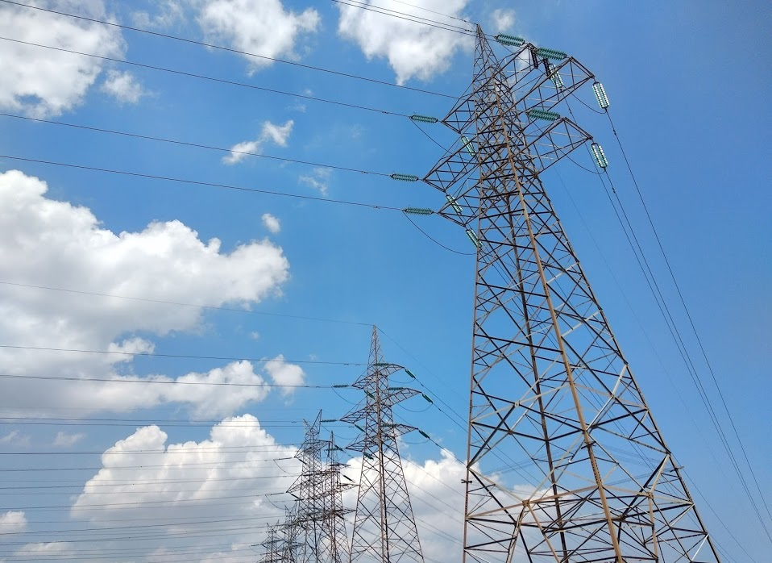

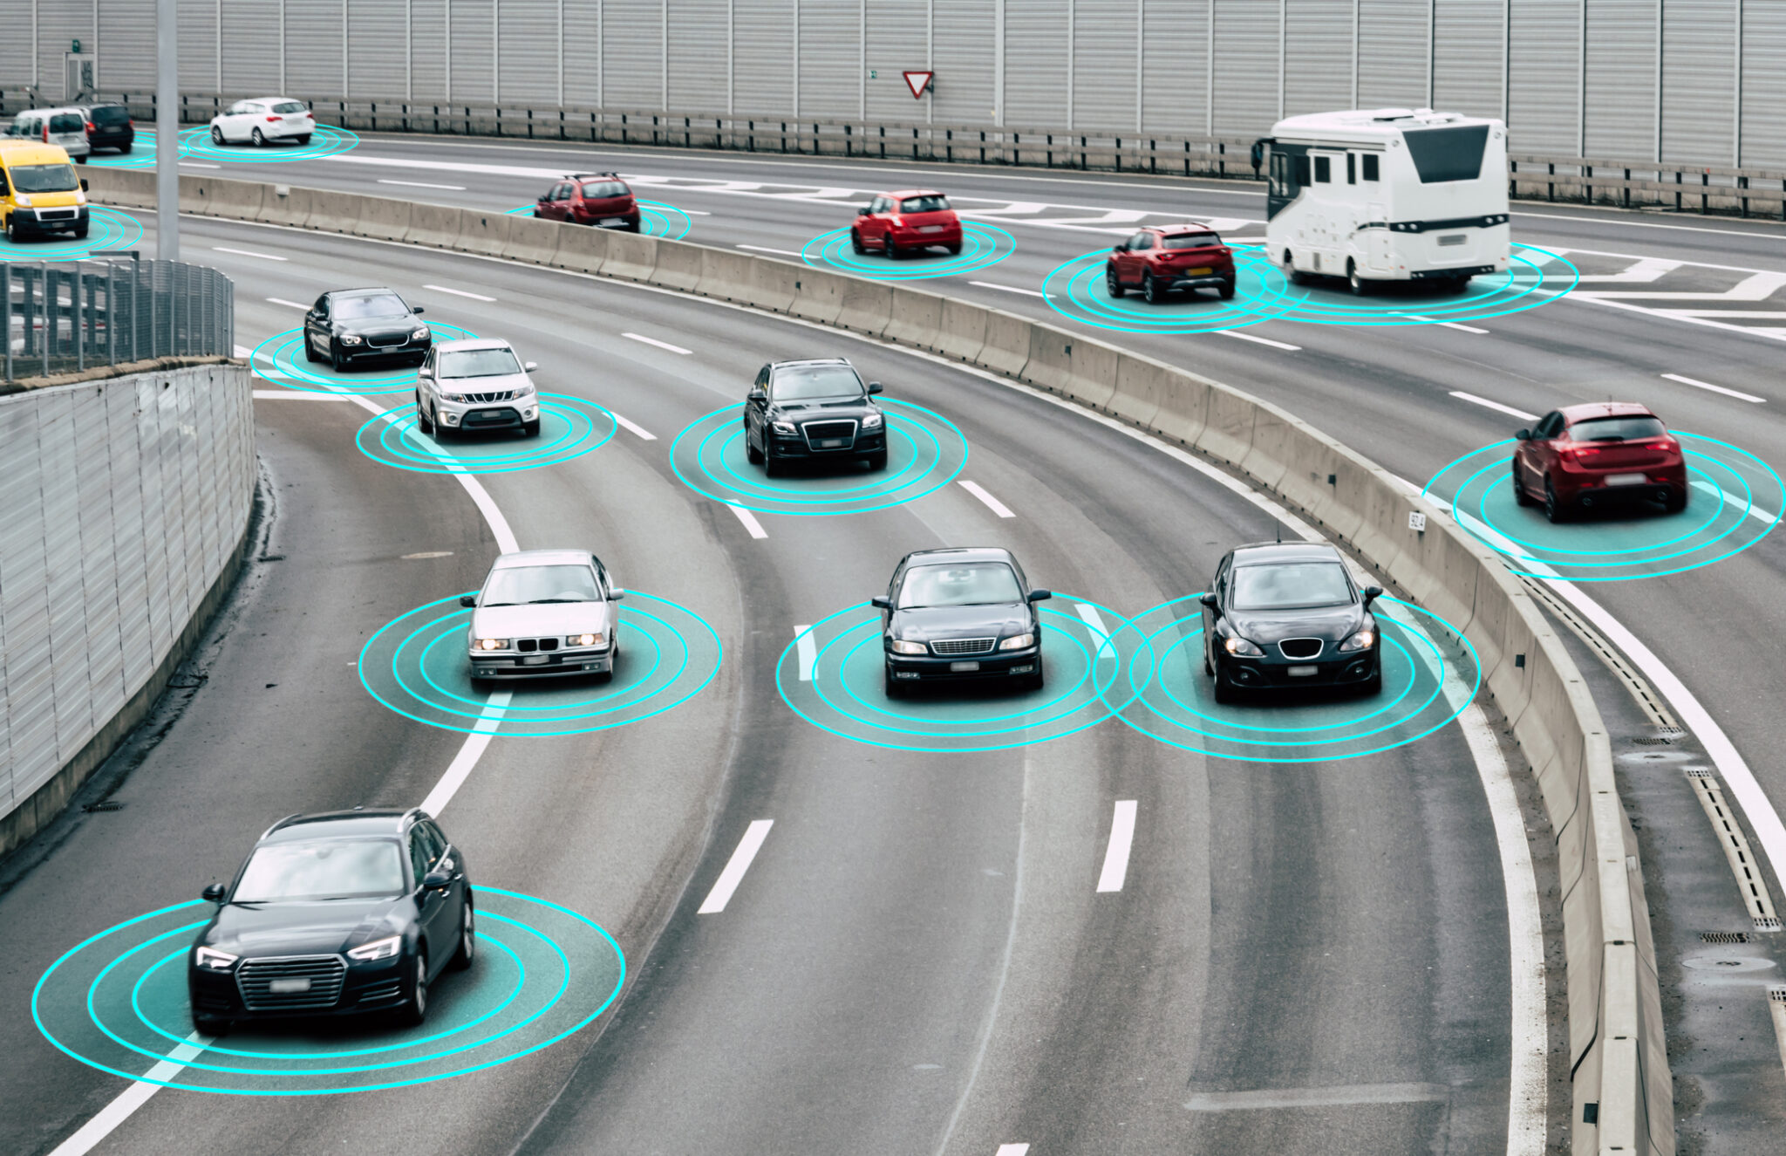
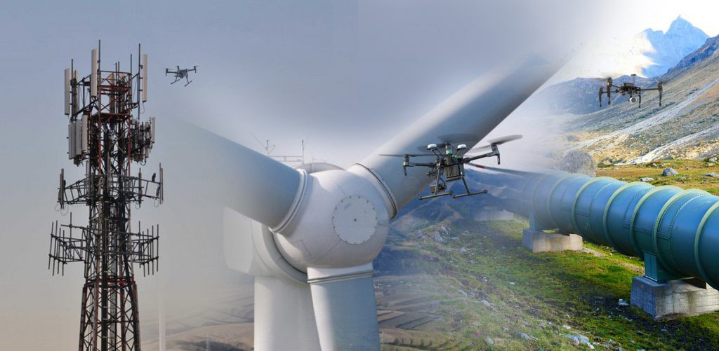
5G Use Cases
Broadband-like Mobile Services
Autonomous Vehicles
Augmented Reality / Virtual Reality
Critical Infrastructures
Smart grids and time-critical scenarios
Video surveillance with drones
https://www.ericsson.com/4a970a/assets/local/networks/cases/intelligent-energy-distribution-with-5g.pdf

Slide 14
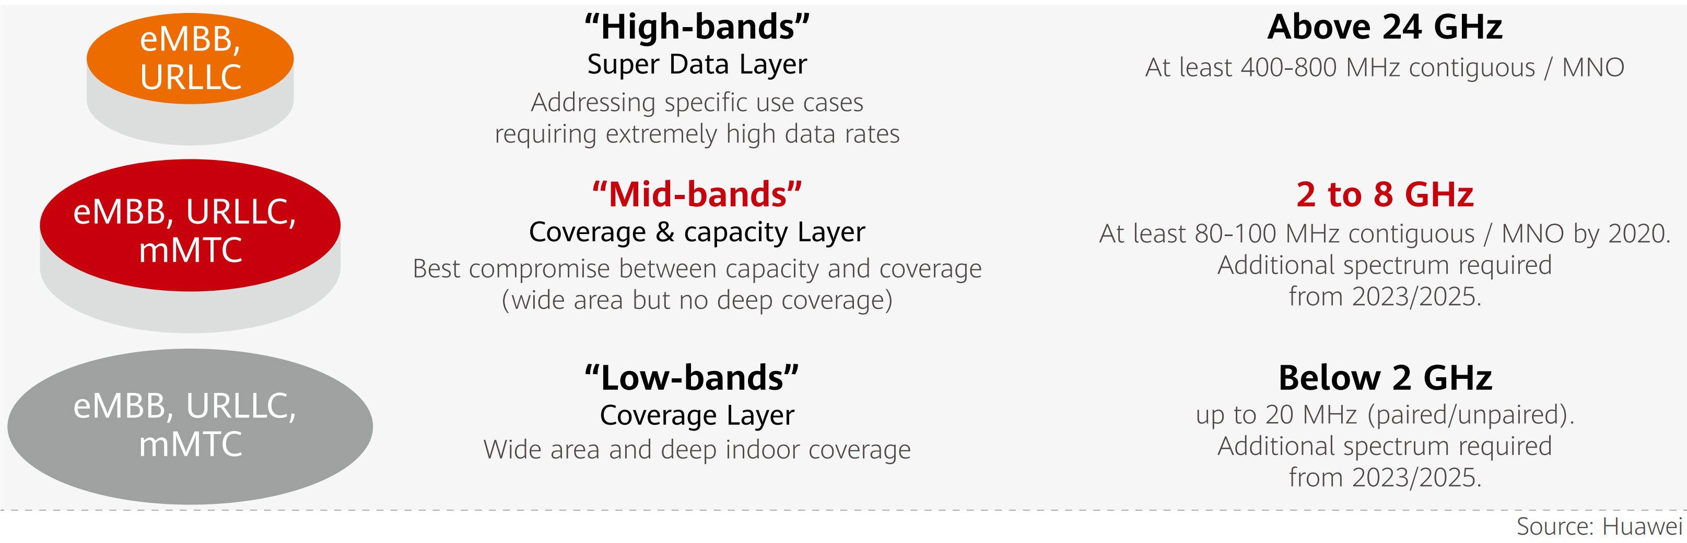
5G Spectrum Plan
https://www.itu.int/en/ITU-D/Regional-Presence/Europe/Documents/Events/2017/Spectrum%20Management/Ulrich__Nokia__5G_in%20700w.pdf
Aim: Globally harmonized spectrum plan for maximum compatibility
Three main frequency bands:
Sub-GHz band ( < 1 GHz)
Mid-band ( 1 – 6 GHz)
mm-wave ( > 6 GHz)
5G Europe Spectrum:
700 MHz
3.4 – 3.8 GHz
26 GHz
Source: Huawei
https://www.qualcomm.com/media/documents/files/spectrum-for-4g-and-5g.pdf

Slide 15
5G European Bands
700 MHz layer with 1 ms latency
Large area coverage
Outdoor to indoor penetration
mMTC and URLLC support
Moderate invest on existing 800/900 MHz grids
3.4 – 3.8 GHz with ~1 Gbps and 1 ms latency
Dense urban coverage, including airport, stadium and public transport
Limited eMMB support
26 GHz layer with ~10 Gbps and 1 ms latency
Coverage in selected hot spots (airport, stadium, press centre)
Full eMMB support

Slide 16
3GPP 5G Architecture (release 15, aka 5G phase #1)
The 3GPP 5G system architecture is service based → Architectural elements are network functions integrated in a virtualised environment
5G = 5G RAN + 5G Core
RAN = Radio Access Network
Core is responsible for non-radio functions: authentication, roaming, handoffs, end-to-end connections
Two deployment methods
Non-Standalone (NSA): Use legacy EPC core with 5G RAN to accelerate 5G NR deployments
Standalone (SA): Full 5G RAN + 5G Core
Each core service is a function, and several functions can be implemented in a physical node or Virtual Machine

Slide 17
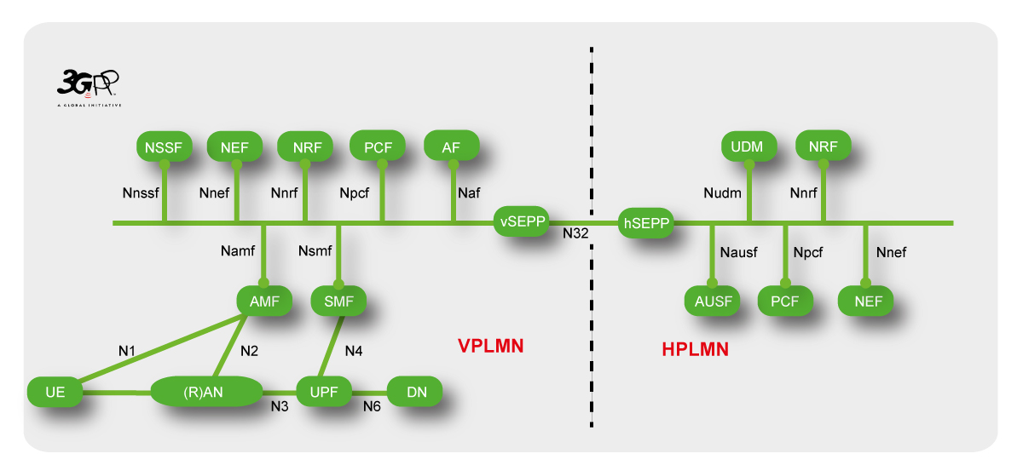
3GPP 5G Architecture – Roaming with local breakout example
https://www.mpirical.com/glossary
Security Edge Protection Proxy
Network Exposure Function
Policy Control
NF Repository
Unified Data Management
Application Functions
Network Slice Selection
Core Access and Mobility Management
Session Management Function
Authentication Server Function
User Plane
Data Network
VPLMN = Visited Public Land Mobile Network
HPLMN = Home PLMN

Slide 18
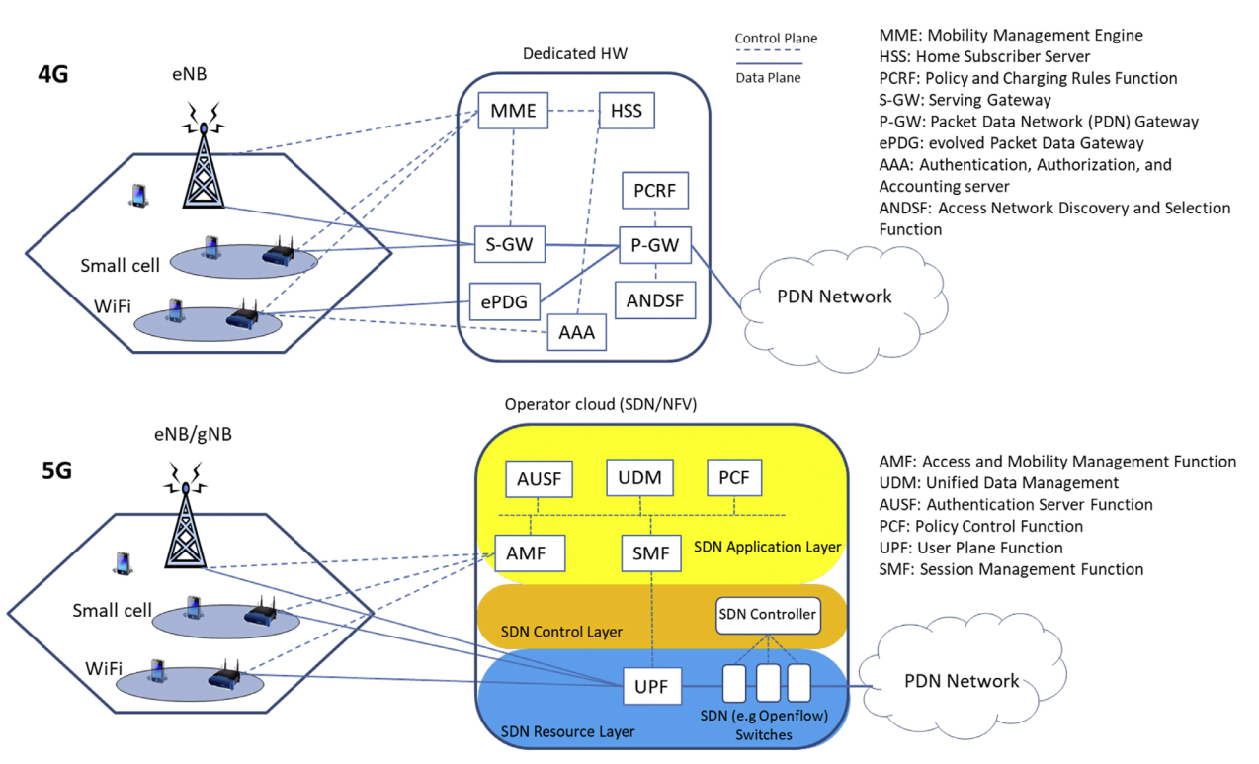
4G vs 5G
https://www.sciencedirect.com/science/article/abs/pii/S1389128619306346

Slide 19
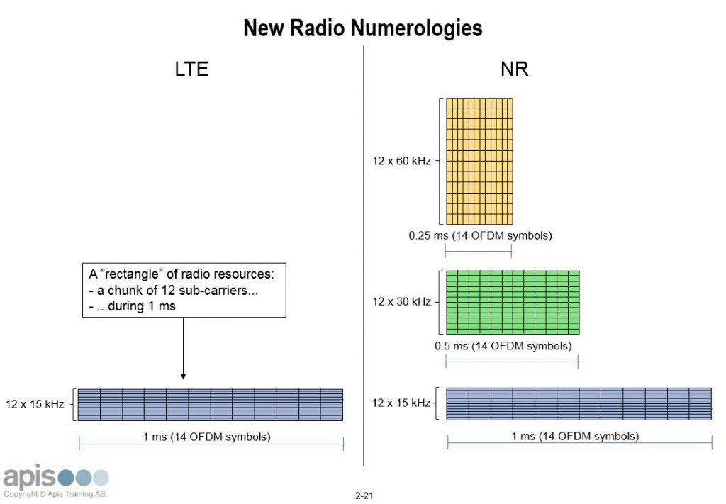
Scalable OFDM
Δf = 15 kHz * 2^{n}
Orthogonal Frequency Division Multiplexing is the right candidate for 5G NR
5G innovation is the scalable OFDM multi-tone 2n numerology
LTE supports carrier bandwidths up to 20 MHz – Fixed OFDM sub-carrier spacing of 15 KHz
5G supports scalable OFDM numerology, meaning smaller OFDM symbol duration and doubled subcarrier spacing when required
Smaller symbol duration means more flexible resource allocation and increased speeds
High frequencies introduce increased phase noise → Larger subcarrier spacing required
https://apistraining.com/news/5g-numerology/

Slide 20
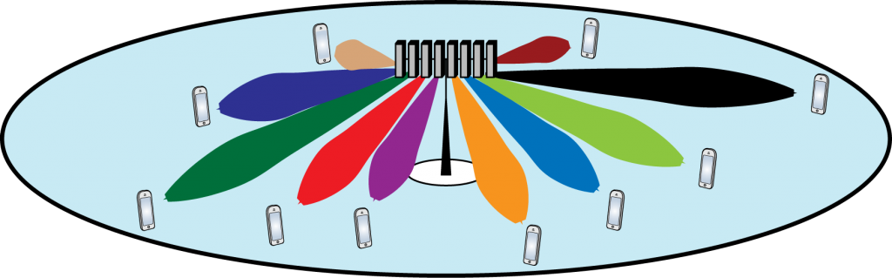
Massive MIMO
Sub-6 GHz wireless access technology
Base stations are equipped with arrays of many ( → massive) antennas that serve multiple users at the same time-frequency resource
Whilst standard MIMO uses 2-4 antennas, massive MIMO uses as many as 96 to 128 antennas

Slide 21
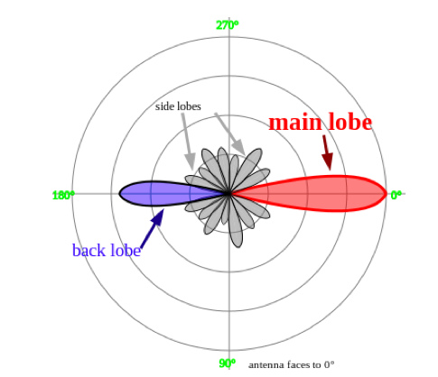
Massive MIMO / Beamforming
The capacity is multiplied without requiring more spectrum
Leverages beamforming to focus wireless signal towards a specific receiving device
Beamforming is utilised by 802.11ax (WiFi 6)
Benefits of massive MIMO
Increased network capacity
Improved coverage
User experience

Slide 22
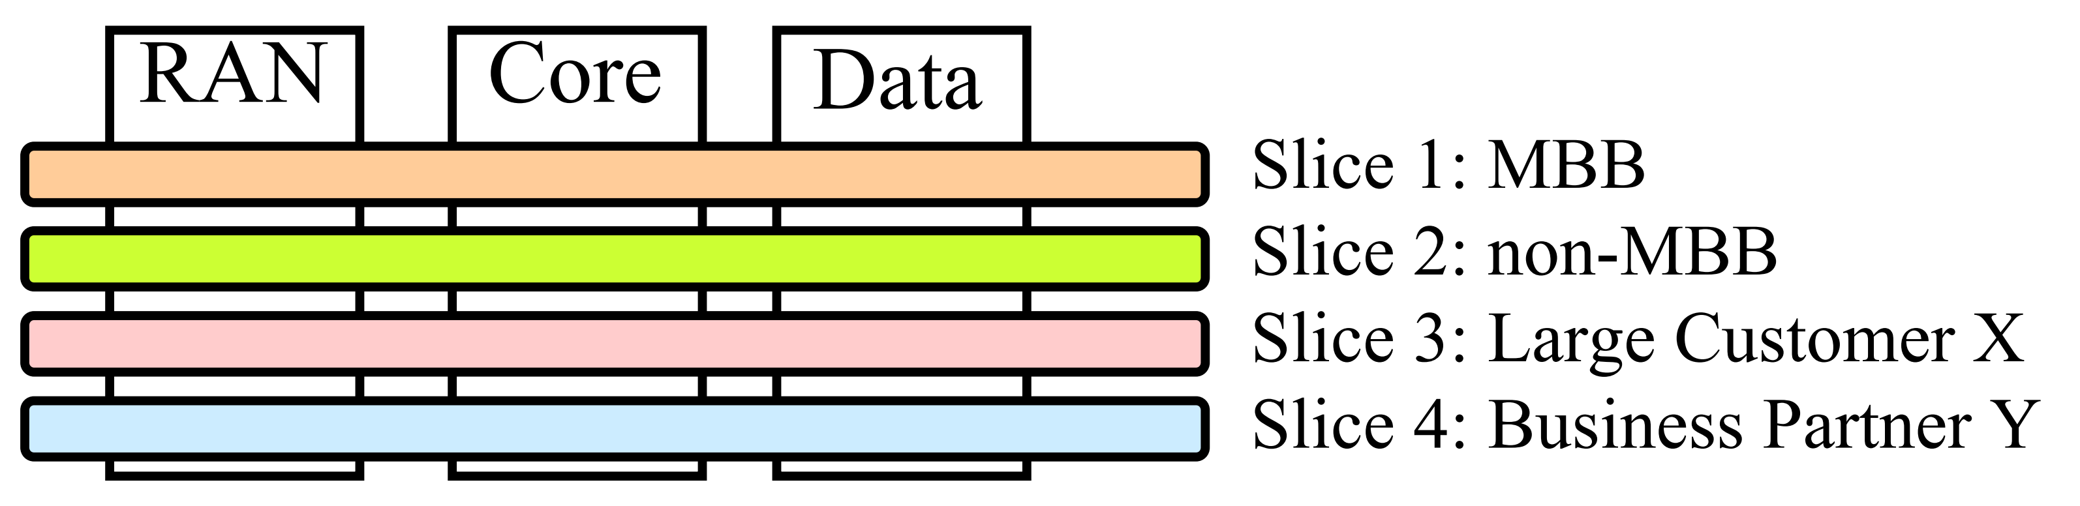
5G Slicing
Slice: A logical network serving a particular application, business partner, or customer
Like Virtual Machines (VMs) on a computer
A network can be divided into many slices
Each slice looks to the user as a separate network with reserved resources
Concerns a use case of Network function virtualization!
https://www.itu.int/en/ITU-T/Workshops-and-Seminars/201707/Documents/Eric_Guttman_5G%20New%20Radio%20and%20System%20Standardization%20in%203GPP.pdf

Slide 23
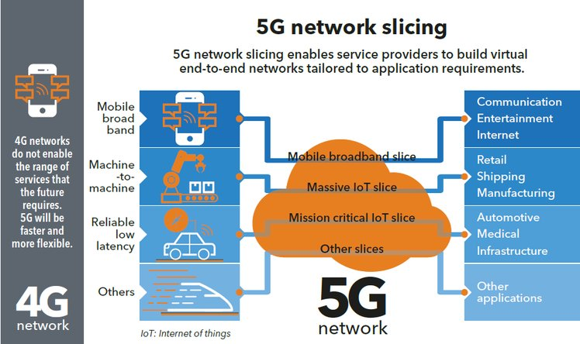
Source: ITUNews

Slide 24
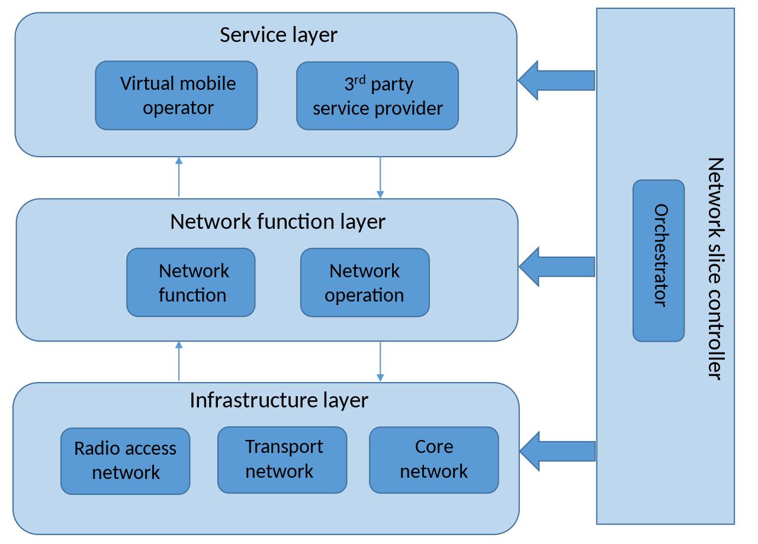
What is a slice?
A set of resources that is defined by 3 layers:
Infrastructure Layer: The actual physical resources utilized (radio frequencies, intermediary nodes/physical topology)
Network Function Layer: Defines the slice as a virtual resource as well as its lifecycle
Service Layer: Operators and service providers can utilize the slices provided by the NF Layer
Network Slice Controller
End-to-end service management
Virtual resource definition
Slice life-cycle management

Slide 25
Neutral Hosting
Network virtualisation introduces new business models!
Neutral hosting exploits network virtualization to separate network infrastructure from the service provider
Mobile Network Operator (MNO): Owner of physical infrastructure (radio frequencies, antennas etc)
Mobile Virtual Network Operator (MVNO): Rents slices from MNO in wholesale price and resells them to customers with custom branding and marketing
There is a global trend in various industries to separate infrastructure providers and service provider (e.g. in energy)

Slide 26
Network evolution
Cloud-Radio Access Network
Multi-Access Edge Computing

Slide 27
Cloud Radio Access Network (C-RAN)
Traditionally (RAN instead of C-RAN):
Each base station covers a small area
A base station consists of the Remote Radio Head (RRH) and the Baseband Unit (BBU)
RRH → Radio transceiver, the physical air interface
BBU → Baseband signal processing
Each base station processes and transmits signals from/to UEs
Payload is forwarded to the core network via the backhaul
5G C-RAN:
RRH and BBU are decoupled – Separated
RRHs transmit “raw” signal to a centralized BBU which is virtualized and hosted on the cloud
Allows scaling for low-cost dense small cells
Optical fibre, 10+ Gbit Ethernet or microwave ~ 20km of front haul

Slide 28
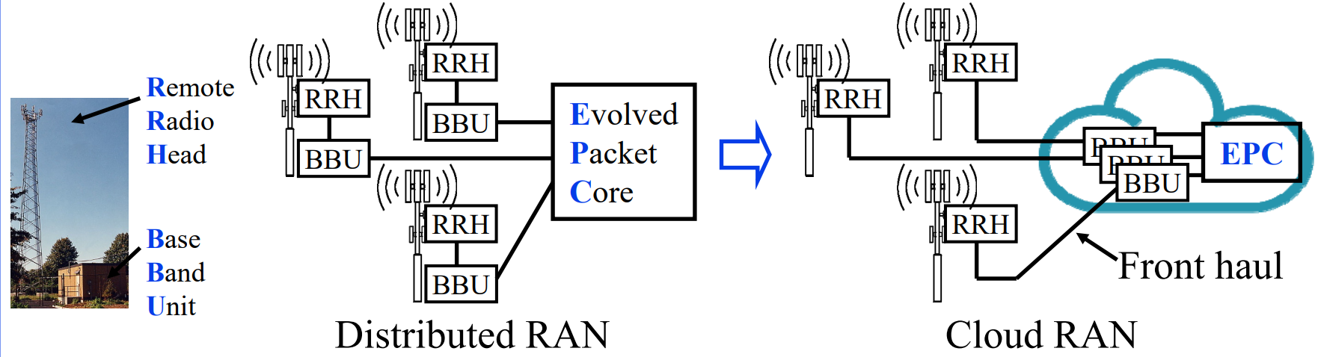
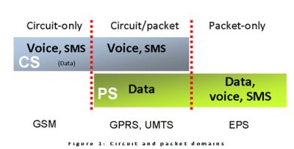
Distributed vs Cloud RAN
https://www.multefire.org/wp-content/uploads/5G_Standard_Toskala_MUulteFire-Open-Day-Meeting.pdf

Slide 29
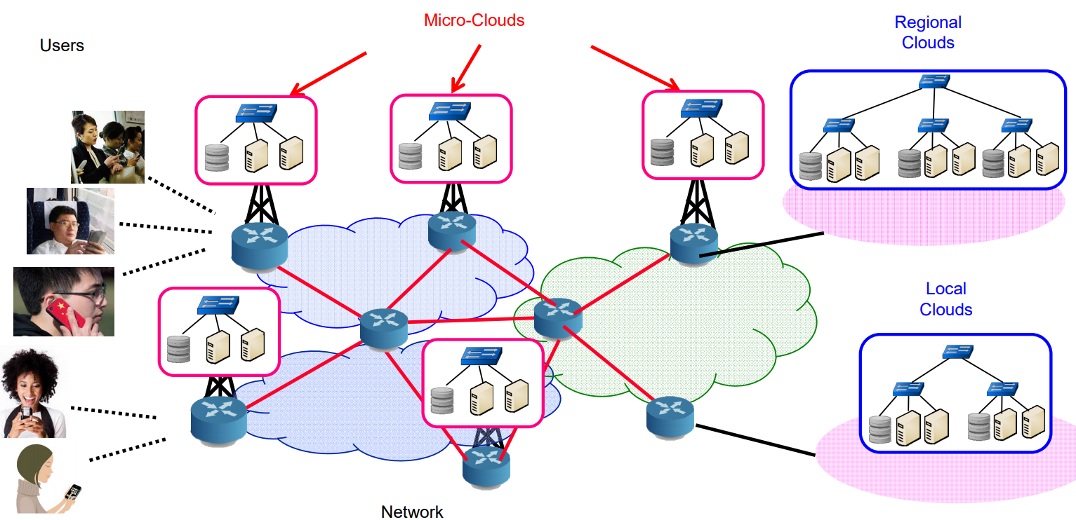
Multi-Access Edge Computing (MEC)
MEC brings computation and cloud closer to the edge

Slide 30
Multi-Access Edge Computing (MEC)
Aims to bring cloud computing capabilities closer to the end-user premises
Cloud suffers from unavoidable latency
5G + edge = mobile edge computing → Leverages 5G connectivity for wireless URLLC in the customer premises
The end user has direct access and control over the local Radio Access Network (RAN)
Core network is relieved from additional traffic and real-time information can be served more efficiently
The result of converging IT and telecommunications networking
New vertical use cases that have strict latency requirements, including:
VR glasses that are in sync with the movement
Remote surgery
Remotely operating manufacturing equipment
Federated Learning / Local AI training and detection
https://www.etsi.org/technologies/multi-access-edge-computing

Slide 31
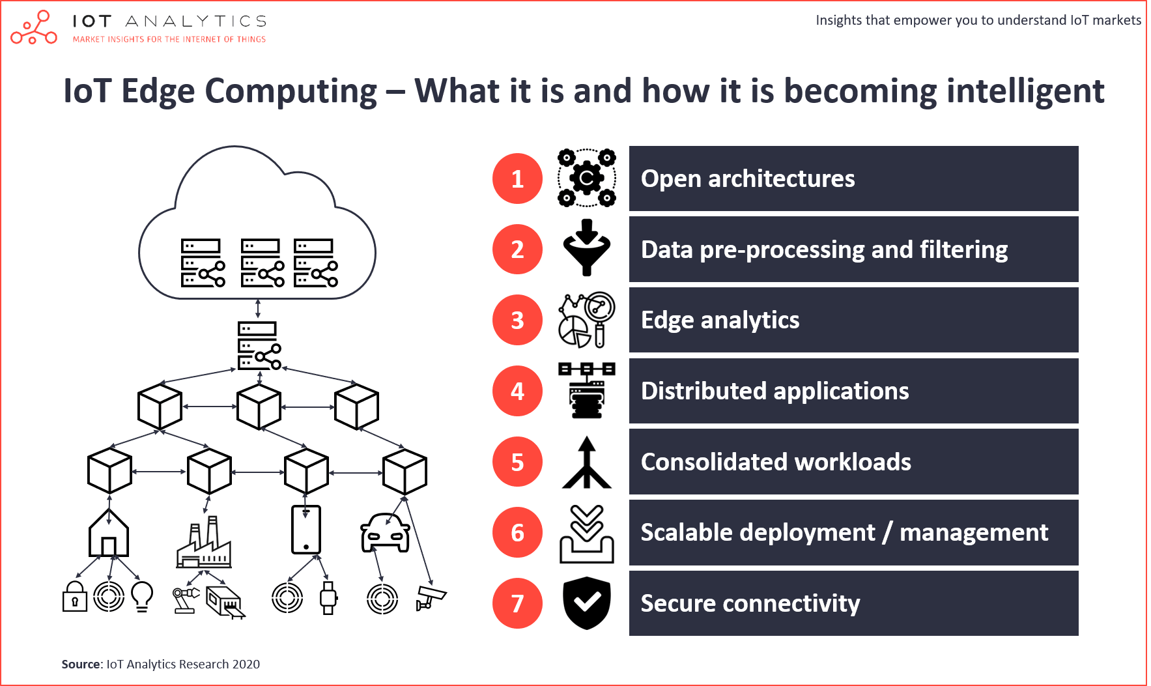

Slide 32
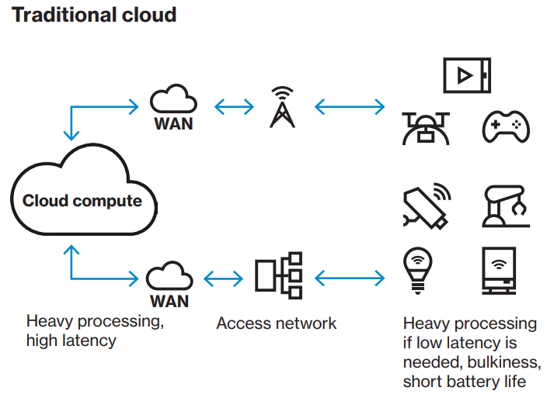
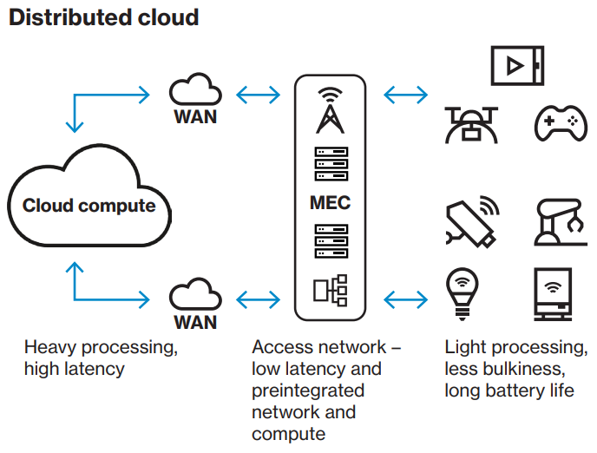
Multi-Access Edge Computing (MEC)
MEC merges edge computing with cloud computing
Brings every latency-strict or data-heavy application closer to the data source
MEC addresses data privacy requirements / Compliance with GDPR
Sensitive data should remain and be processed on the edge
https://enterprise.verizon.com/content/dam/resources/whitepapers/5g-and-edge-computing.pdf

Slide 33
MEC and 5G use cases
Autonomous and assisted-driving vehicles → A single autonomous vehicle can produce 30 TB per day (Twitter’s daily data)
AR/VR/MR/XR (Augmented, Virtual, Mixed, Extended) Reality → Hyperrealistic training, medical imaging, remote repair, augmented retail, safety and security
Media delivery → Reliable 4k/8k video streaming
Smart safety → Enhanced training, improve responsiveness to safety incidents
Massive IoT → Drive analytics and artificial intelligence with huge amounts of sensors.
Predictive maintenance and proactive actions → Predict upcoming faults and enable proactive actions in order to prevent cascading effects (e.g. fault in electrical system)

Slide 34
Towards 3GPP Release 16
NR V2X (Vehicle to Anything)
Vehicle Platooning (group of vehicles that travelling together in an optimal way)
Remote driving and extended sensors for data/video sharing
Non-terrestrial Networks
5G through satellites
Unmanned aircrafts as cell towers
Above 52.6 GHz
IoT-centric
MEC / Private 5G network for Industrial IoT
Usage of unlicensed spectrum
https://www.qualcomm.com/media/documents/files/expanding-the-5g-nr-ecosystem-and-roadmap-in-3gpp-rel-16-beyond.pdf

Slide 35

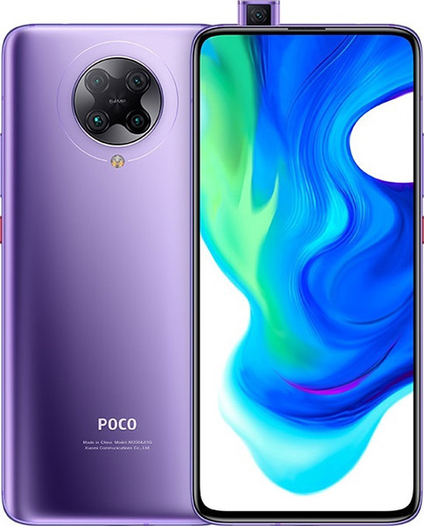




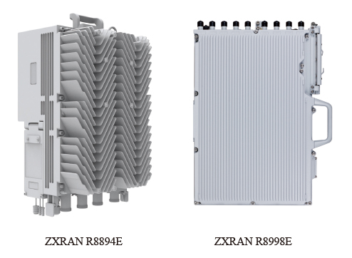
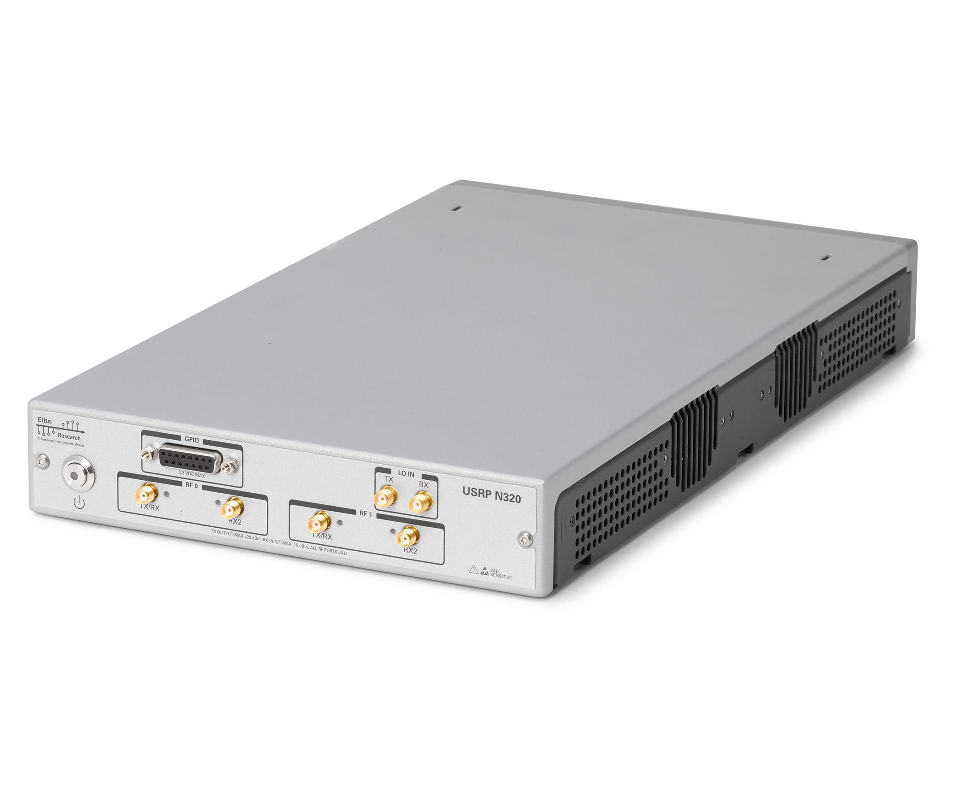
How to implement?
Software-Defined Radio (ETTUS)

Slide 36
5G Demonstration by NOKIA
Nokia 5G Demonstration Video – 5G: driving the automation of everything - YouTube

